Slide 1
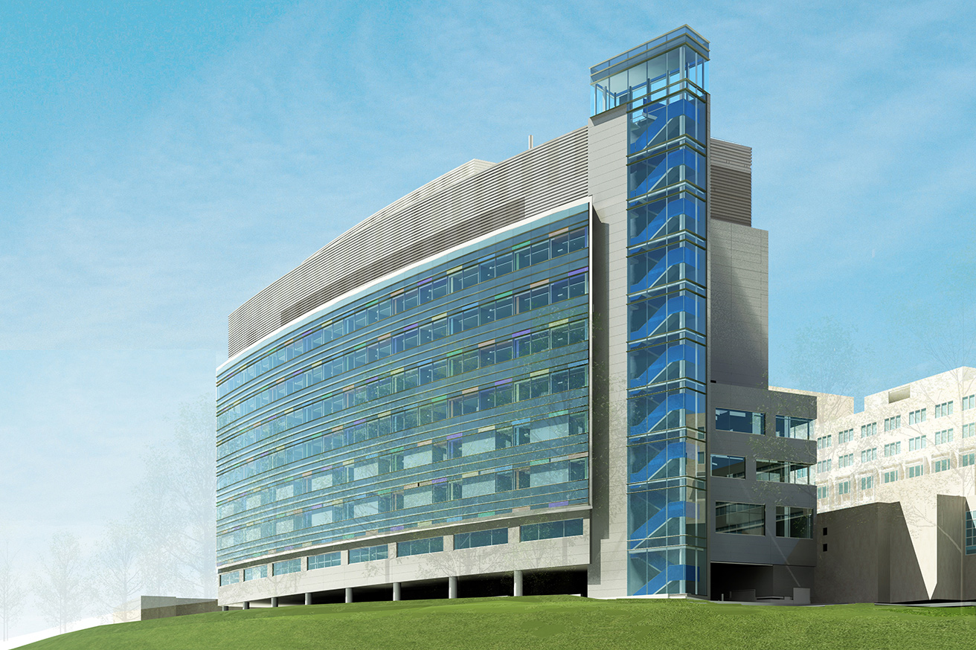
Northeast Hospital Expansion
Courtesy of Smith Group JJR
Penn State AE Senior Thesis Project
Joshua Miller | Construction Management Option
Faculty Advisor | Craig Dubler

Slide 2

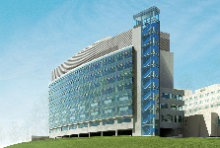



AE Senior Thesis Project
Joshua Miller | Construction Management Option
Introduction
Northeast Hospital Expansion
123 Medical Lane, USA
I. Introduction
Project Background
Analysis Overview
II. Analysis 1: Implementing an Integrated Project Delivery
Current Delivery Method
Case Studies of Similar Projects Using IPD
Suggested Methods for Implementation
III. Analysis 2: Patient Room Re-Design for Shared Wet Wall
Existing/Proposed Patient Room Layout
Mechanical Breadth: Piping Re-Sizing
Cost and Schedule Impact
IV. Analysis 3: SIPS Utilization for Patient Floors
Original Crew Sizes & Proposed Work Zones
Workflow Balancing
Cost and Schedule Impact
V. Conclusions & Recommendations
VI. Acknowledgements
Project Background
Building Information
  234,000 SF
  10 Stories
  120 Private Patient Rooms
  $230 Million ($121 million for new patient tower)
Key
Elect. Main
Water Main
Project Schedule
  Start Date: January 2013
  Completion Date: September 2015
  Total Duration: 973 work days
Const. Parking
Ambulance
Bay/Access
Project Manager
  Whiting-Turner
  Construction Manager at Risk
  Guaranteed Maximum Price
Const. Access
Res. Zoning
New Const.

Slide 3
AE Senior Thesis Project
Joshua Miller | Construction Management Option
Introduction
Northeast Hospital Expansion
123 Medical Lane, USA
I. Introduction
Project Background
Analysis Overview
II. Analysis 1: Implementing an Integrated Project Delivery
Current Delivery Method
Case Studies of Similar Projects Using IPD
Suggested Methods for Implementation
III. Analysis 2: Patient Room Re-Design for Shared Wet Wall
Existing/Proposed Patient Room Layout
Mechanical Breadth: Piping Re-Sizing
Cost and Schedule Impact
IV. Analysis 3: SIPS Utilization for Patient Floors
Original Crew Sizes & Proposed Work Zones
Workflow Balancing
Cost and Schedule Impact
V. Conclusions & Recommendations
VI. Acknowledgements
Analysis Overview
Analysis 1: Implementing an Integrated Project Delivery
Observing how similar projects in the US are implementing IPD strategies that could have been used to create a more efficient project team and suggesting how apply these methods.
Analysis 3: SIPS Utilization for Patient Floors
Applying short interval production scheduling to the MEP installations and finishes on the private patient floors for an accelerated schedule and more balanced workflow.
Analysis 2: Patient Room Re-Design for Shared Wet Wall
Re-evaluating the plumbing design for the private patient rooms to create a more efficient design that potentially saves on labor time and material costs.
Mechanical Breadth: Re-sizing the sanitary, vent, and the cold and hot water supplies
Analysis 4: Preassembled Steel Connection Bridge
Identifying sections of the bridge connecting the existing hospital to the patient tower addition for preassembly in order to create a safer work environment and reduce the time spent on steel erection.
Structural Breadth: Verifying the preassembled sections can be picked by the crane and designating pick points .

Slide 4
AE Senior Thesis Project
Joshua Miller | Construction Management Option
Northeast Hospital Expansion
123 Medical Lane, USA
I. Introduction
Project Background
Analysis Overview
II. Analysis 1: Implementing an Integrated Project Delivery
Current Delivery Method
Case Studies of Similar Projects Using IPD
Suggested Methods for Implementation
III. Analysis 2: Patient Room Re-Design for Shared Wet Wall
Existing/Proposed Patient Room Layout
Mechanical Breadth: Piping Re-Sizing
Cost and Schedule Impact
IV. Analysis 3: SIPS Utilization for Patient Floors
Original Crew Sizes & Proposed Work Zones
Workflow Balancing
Cost and Schedule Impact
V. Conclusions & Recommendations
VI. Acknowledgements
Analysis 1: Implementing an Integrated Project Delivery

Slide 5
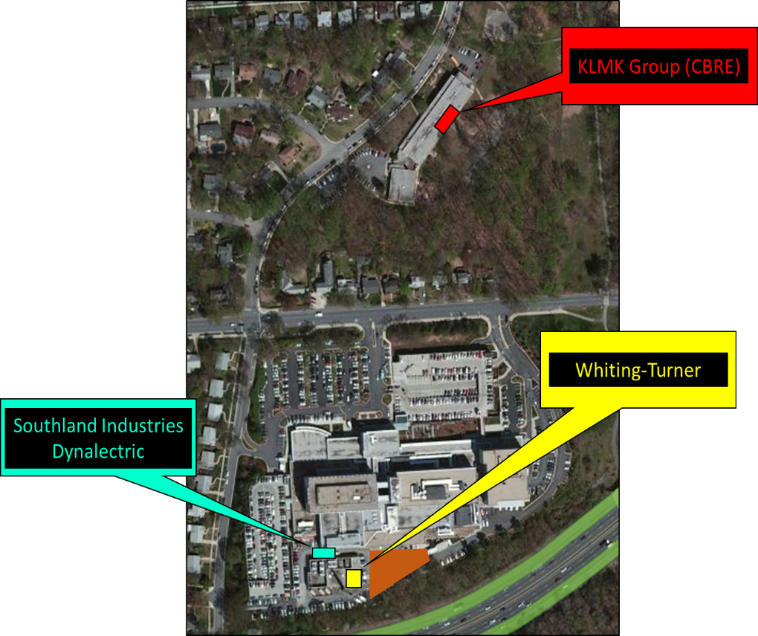
Analysis 1: Implementing an Integrated Project Delivery
AE Senior Thesis Project
Joshua Miller | Construction Management Option
Northeast Hospital Expansion
123 Medical Lane, USA
I. Introduction
Project Background
Analysis Overview
II. Analysis 1: Implementing an Integrated Project Delivery
Current Delivery Method
Case Studies of Similar Projects Using IPD
Suggested Methods for Implementation
III. Analysis 2: Patient Room Re-Design for Shared Wet Wall
Existing/Proposed Patient Room Layout
Mechanical Breadth: Piping Re-Sizing
Cost and Schedule Impact
IV. Analysis 3: SIPS Utilization for Patient Floors
Original Crew Sizes & Proposed Work Zones
Workflow Balancing
Cost and Schedule Impact
V. Conclusions & Recommendations
VI. Acknowledgements
Current Delivery Method
9 miles
Smith Group JJR
Owner
13 miles
Loiederman Soltesz Associates
Smith Group JJR
Architect
16.4 miles
Whiting -Turner
Construction Manager at Risk
McMullan & Associates, Inc.
24 miles
Leach Wallace Associates, Inc.
McMullan & Associates, Inc.
Structural Engineer
26 miles
Southland Industries
Mech/Plumbing Contractor
Syska Hennessey Group
Leach Wallace Associates, Inc.
MEP/FP Engineering
Dynalectric
Electrical Contractor
Project | Multi-Party contract | Liability Waivers | Risk/ Reward Pool | Integrated Team Structure | Early Involvement of Key Players | Co-location | Network Sharing
Northeast Hospital Expansion |  |  |  |  |  |  | 
Syska Hennessey Group
MEP/FP Engineering
Other Subcontractors
Loiederman Soltesz Associates
Civil Engineers

Slide 6
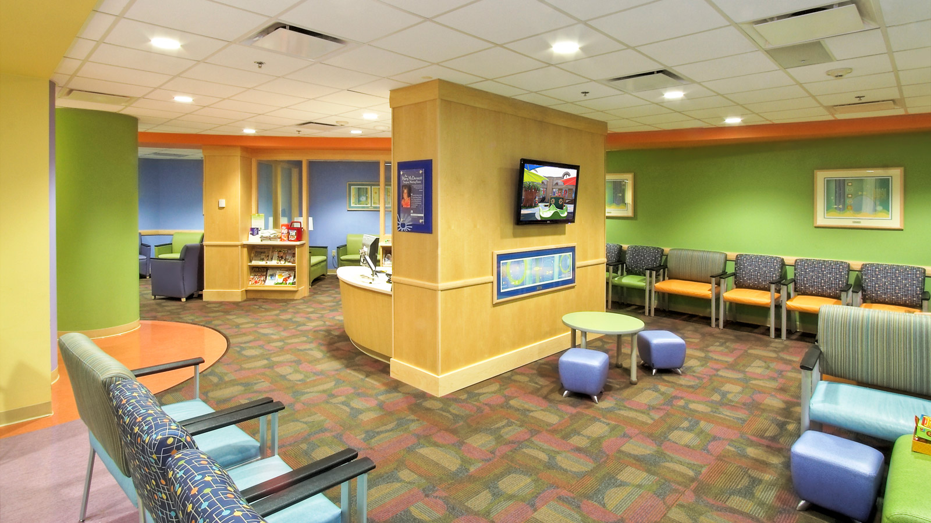
Analysis 1: Implementing an Integrated Project Delivery
AE Senior Thesis Project
Joshua Miller | Construction Management Option
Northeast Hospital Expansion
123 Medical Lane, USA
I. Introduction
Project Background
Analysis Overview
II. Analysis 1: Implementing an Integrated Project Delivery
Current Delivery Method
Case Studies of Similar Projects Using IPD
Suggested Methods for Implementation
III. Analysis 2: Patient Room Re-Design for Shared Wet Wall
Existing/Proposed Patient Room Layout
Mechanical Breadth: Piping Re-Sizing
Cost and Schedule Impact
IV. Analysis 3: SIPS Utilization for Patient Floors
Original Crew Sizes & Proposed Work Zones
Workflow Balancing
Cost and Schedule Impact
V. Conclusions & Recommendations
VI. Acknowledgements
Case Studies of Similar Projects Using IPD
Cardinal Glennon Children’s Hospital
Project | Multi-Party contract | Liability Waivers | Risk/ Reward Pool | Integrated Team Structure | Early Involvement of Key Players | Co-location | Network Sharing
Northeast Hospital Expansion |  |  |  |  |  |  | 
Cardinal Glennon Children's Hospital Expansion |  |  |  |  |  | 
Courtesy of Christer Inc.

Slide 7
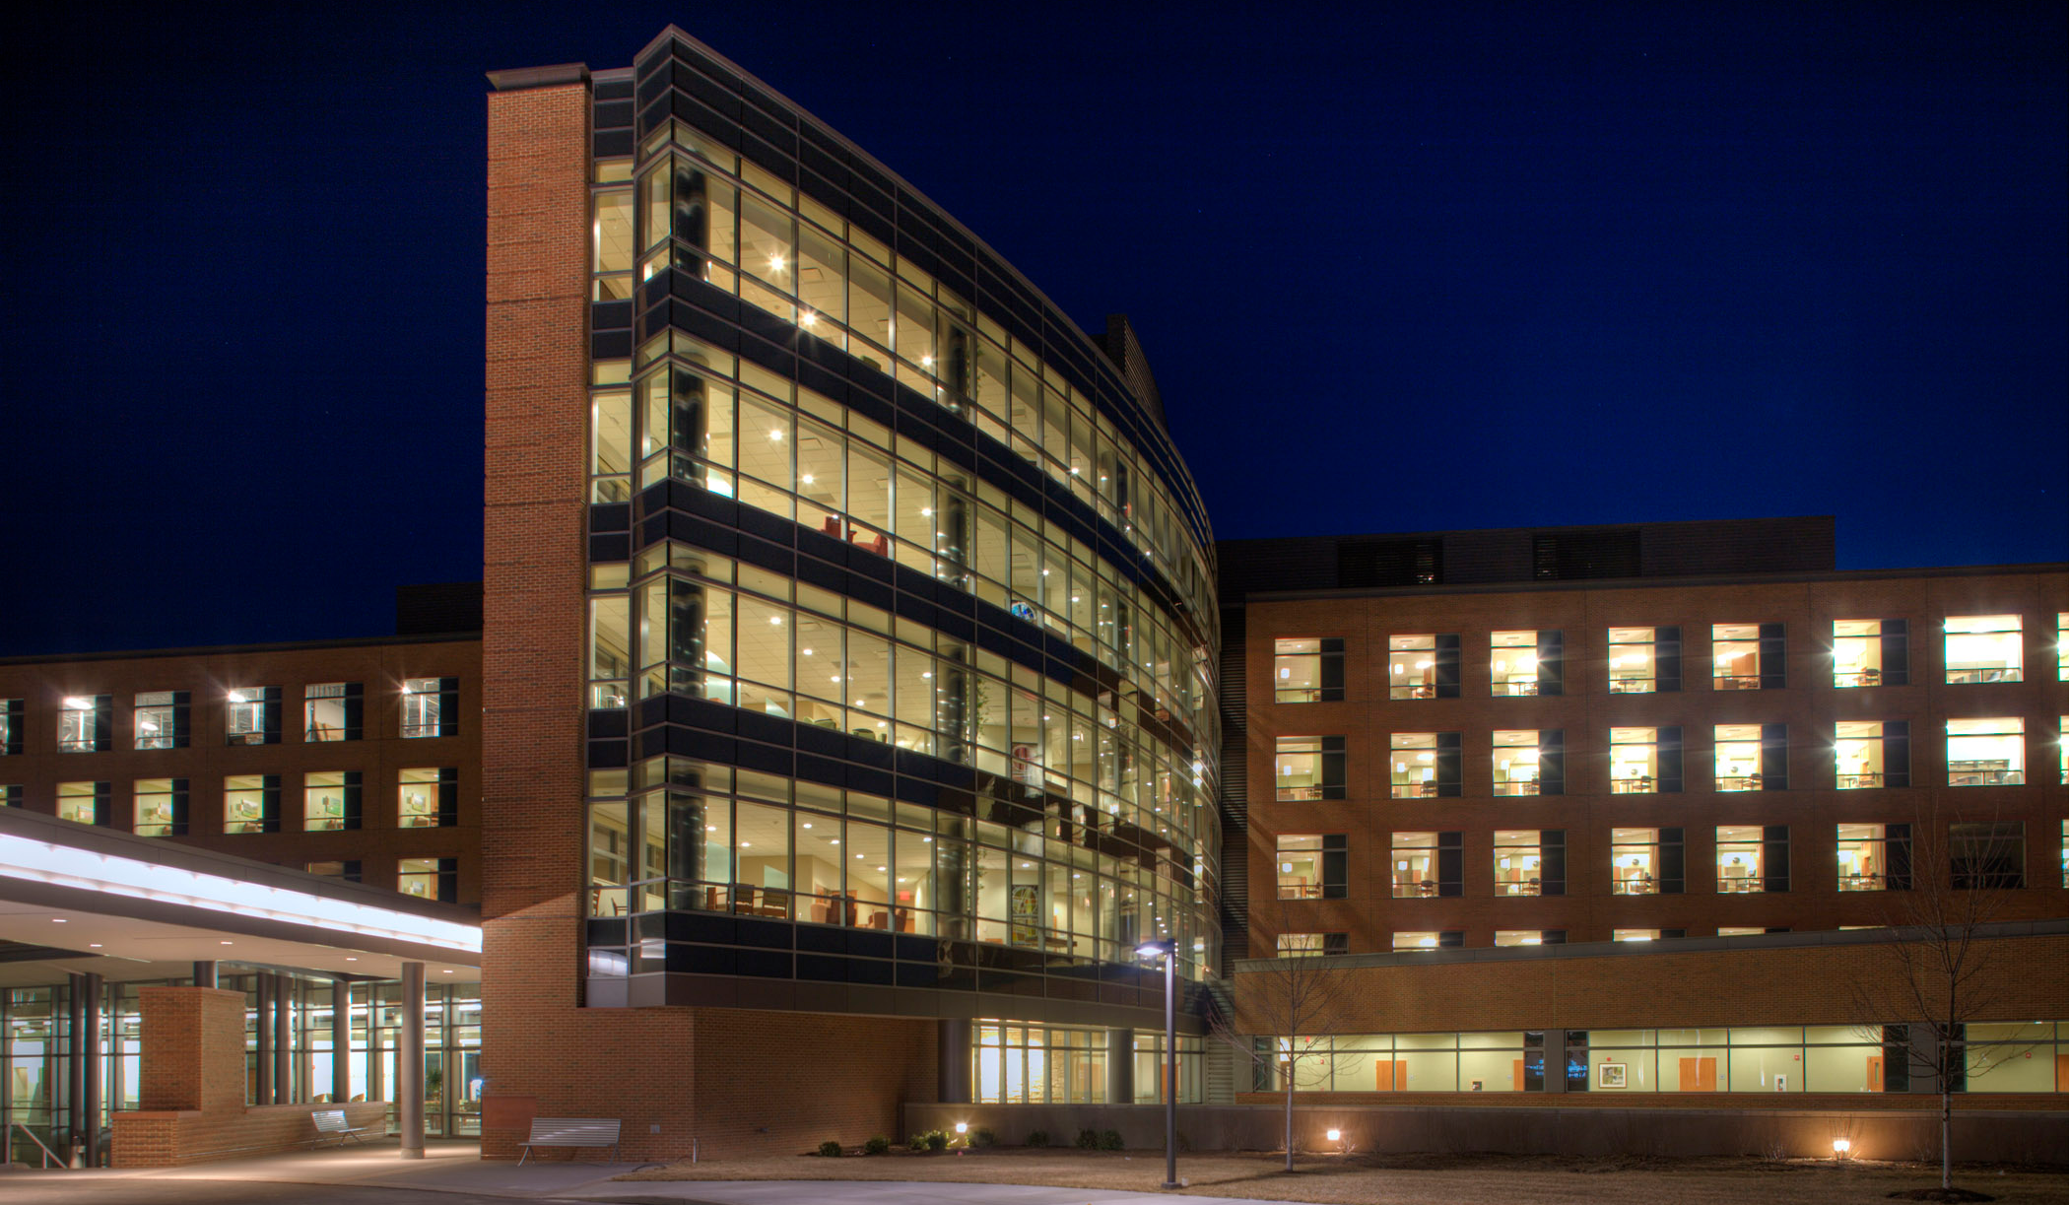
Analysis 1: Implementing an Integrated Project Delivery
AE Senior Thesis Project
Joshua Miller | Construction Management Option
Northeast Hospital Expansion
123 Medical Lane, USA
I. Introduction
Project Background
Analysis Overview
II. Analysis 1: Implementing an Integrated Project Delivery
Current Delivery Method
Case Studies of Similar Projects Using IPD
Suggested Methods for Implementation
III. Analysis 2: Patient Room Re-Design for Shared Wet Wall
Existing/Proposed Patient Room Layout
Mechanical Breadth: Piping Re-Sizing
Cost and Schedule Impact
IV. Analysis 3: SIPS Utilization for Patient Floors
Original Crew Sizes & Proposed Work Zones
Workflow Balancing
Cost and Schedule Impact
V. Conclusions & Recommendations
VI. Acknowledgements
Case Studies of Similar Projects Using IPD
St. Clare Health Center
Project | Multi-Party contract | Liability Waivers | Risk/ Reward Pool | Integrated Team Structure | Early Involvement of Key Players | Co-location | Network Sharing
Northeast Hospital Expansion |  |  |  |  |  |  | 
Cardinal Glennon Children's Hospital Expansion |  |  |  |  |  | 
St. Clare Health Center |  |  |  |  |  |  | 
Courtesy of Kwame Building Group.

Slide 8
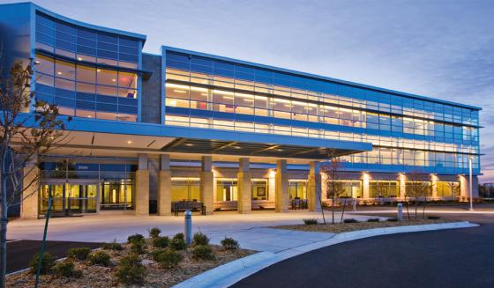
Analysis 1: Implementing an Integrated Project Delivery
AE Senior Thesis Project
Joshua Miller | Construction Management Option
Northeast Hospital Expansion
123 Medical Lane, USA
I. Introduction
Project Background
Analysis Overview
II. Analysis 1: Implementing an Integrated Project Delivery
Current Delivery Method
Case Studies of Similar Projects Using IPD
Suggested Methods for Implementation
III. Analysis 2: Patient Room Re-Design for Shared Wet Wall
Existing/Proposed Patient Room Layout
Mechanical Breadth: Piping Re-Sizing
Cost and Schedule Impact
IV. Analysis 3: SIPS Utilization for Patient Floors
Original Crew Sizes & Proposed Work Zones
Workflow Balancing
Cost and Schedule Impact
V. Conclusions & Recommendations
VI. Acknowledgements
Case Studies of Similar Projects Using IPD
Encircle Health’s Ambulatory Care Center
Project | Multi-Party contract | Liability Waivers | Risk/ Reward Pool | Integrated Team Structure | Early Involvement of Key Players | Co-location | Network Sharing
Northeast Hospital Expansion |  |  |  |  |  |  | 
Cardinal Glennon Children's Hospital Expansion |  |  |  |  |  | 
St. Clare Health Center |  |  |  |  |  |  | 
Encircle Health's Ambulatory Care Center |  |  |  |  |  |  | 
Courtesy of HGA

Slide 9
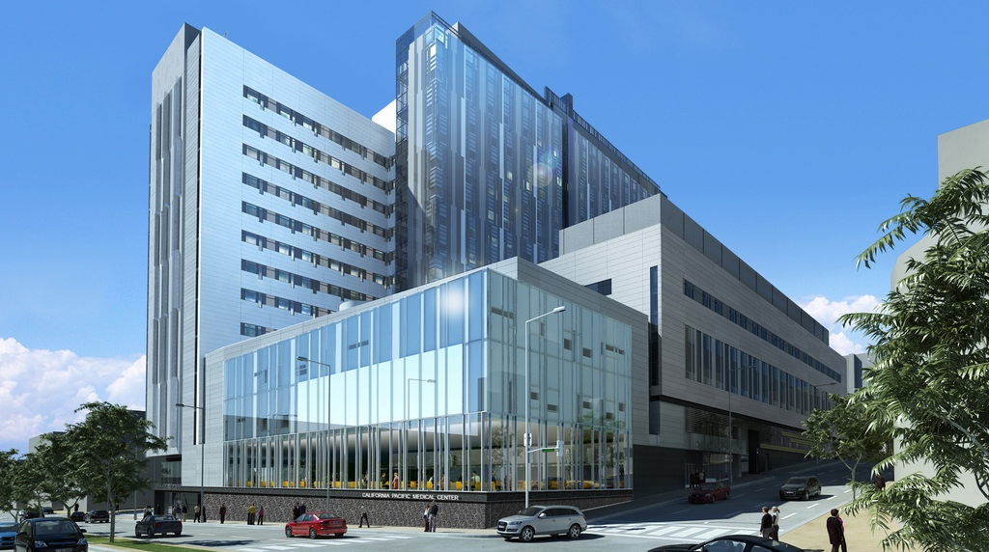
Analysis 1: Implementing an Integrated Project Delivery
AE Senior Thesis Project
Joshua Miller | Construction Management Option
Northeast Hospital Expansion
123 Medical Lane, USA
I. Introduction
Project Background
Analysis Overview
II. Analysis 1: Implementing an Integrated Project Delivery
Current Delivery Method
Case Studies of Similar Projects Using IPD
Suggested Methods for Implementation
III. Analysis 2: Patient Room Re-Design for Shared Wet Wall
Existing/Proposed Patient Room Layout
Mechanical Breadth: Piping Re-Sizing
Cost and Schedule Impact
IV. Analysis 3: SIPS Utilization for Patient Floors
Original Crew Sizes & Proposed Work Zones
Workflow Balancing
Cost and Schedule Impact
V. Conclusions & Recommendations
VI. Acknowledgements
Case Studies of Similar Projects Using IPD
Cathedral Hill Hospital
Courtesy of Smith Group
Project | Multi-Party contract | Liability Waivers | Risk/ Reward Pool | Integrated Team Structure | Early Involvement of Key Players | Co-location | Network Sharing
Northeast Hospital Expansion |  |  |  |  |  |  | 
Cardinal Glennon Children's Hospital Expansion |  |  |  |  |  | 
St. Clare Health Center |  |  |  |  |  |  | 
Encircle Health's Ambulatory Care Center |  |  |  |  |  |  | 
Cathedral Hill Hospital |  |  |  |  |  |  | 

Slide 10
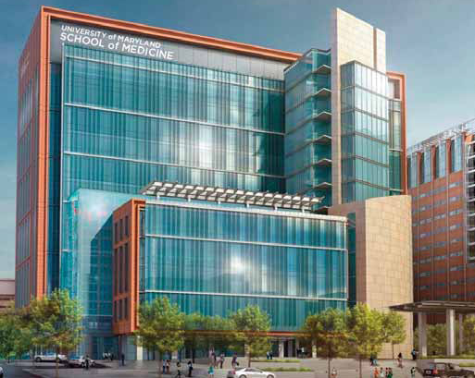
Analysis 1: Implementing an Integrated Project Delivery
AE Senior Thesis Project
Joshua Miller | Construction Management Option
Northeast Hospital Expansion
123 Medical Lane, USA
I. Introduction
Project Background
Analysis Overview
II. Analysis 1: Implementing an Integrated Project Delivery
Current Delivery Method
Case Studies of Similar Projects Using IPD
Suggested Methods for Implementation
III. Analysis 2: Patient Room Re-Design for Shared Wet Wall
Existing/Proposed Patient Room Layout
Mechanical Breadth: Piping Re-Sizing
Cost and Schedule Impact
IV. Analysis 3: SIPS Utilization for Patient Floors
Original Crew Sizes & Proposed Work Zones
Workflow Balancing
Cost and Schedule Impact
V. Conclusions & Recommendations
VI. Acknowledgements
Case Studies of Similar Projects Using IPD
Health Sciences Facility III
Project | Multi-Party contract | Liability Waivers | Risk/ Reward Pool | Integrated Team Structure | Early Involvement of Key Players | Co-location | Network Sharing
Northeast Hospital Expansion |  |  |  |  |  |  | 
Cardinal Glennon Children's Hospital Expansion |  |  |  |  |  | 
St. Clare Health Center |  |  |  |  |  |  | 
Encircle Health's Ambulatory Care Center |  |  |  |  |  |  | 
Cathedral Hill Hospital |  |  |  |  |  |  | 
Health Sciences Facility III |  |  |  |  |  |  | 
Courtesy of the University of Maryland

Slide 11

Analysis 1: Implementing an Integrated Project Delivery
AE Senior Thesis Project
Joshua Miller | Construction Management Option
Northeast Hospital Expansion
123 Medical Lane, USA
I. Introduction
Project Background
Analysis Overview
II. Analysis 1: Implementing an Integrated Project Delivery
Current Delivery Method
Case Studies of Similar Projects Using IPD
Suggested Methods for Implementation
III. Analysis 2: Patient Room Re-Design for Shared Wet Wall
Existing/Proposed Patient Room Layout
Mechanical Breadth: Piping Re-Sizing
Cost and Schedule Impact
IV. Analysis 3: SIPS Utilization for Patient Floors
Original Crew Sizes & Proposed Work Zones
Workflow Balancing
Cost and Schedule Impact
V. Conclusions & Recommendations
VI. Acknowledgements
Suggested Methods for Implementation
Negotiated Space for Part-Time Co-Location
Project | Multi-Party contract | Liability Waivers | Risk/ Reward Pool | Integrated Team Structure | Early Involvement of Key Players | Co-location | Network Sharing
Proposed Northeast Hospital Expansion |  |  |  |  |  |  | 
Northeast Hospital Expansion |  |  |  |  |  |  | 
Cardinal Glennon Children's Hospital Expansion |  |  |  |  |  | 
St. Clare Health Center |  |  |  |  |  |  | 
Encircle Health's Ambulatory Care Center |  |  |  |  |  |  | 
Cathedral Hill Hospital |  |  |  |  |  |  | 
Health Sciences Facility III |  |  |  |  |  |  | 
Smith Group JJR
Architect
Owner
McMullan & Associates, Inc.
Struct. Eng.
Leach Wallace Associates, Inc.
MEP/FP Eng.
Syska Hennessey Group
MEP/FP Eng.
Whiting -Turner
CM at Risk
Other Subcontractors
Southland Industries
Mech/Plumb
Loiederman Soltesz Associates
Civil Eng.
Dynalectric
Electrical

Slide 12
AE Senior Thesis Project
Joshua Miller | Construction Management Option
Northeast Hospital Expansion
123 Medical Lane, USA
I. Introduction
Project Background
Analysis Overview
II. Analysis 1: Implementing an Integrated Project Delivery
Current Delivery Method
Case Studies of Similar Projects Using IPD
Suggested Methods for Implementation
III. Analysis 2: Patient Room Re-Design for Shared Wet Wall
Existing/Proposed Patient Room Layout
Mechanical Breadth: Piping Re-Sizing
Cost and Schedule Impact
IV. Analysis 3: SIPS Utilization for Patient Floors
Original Crew Sizes & Proposed Work Zones
Workflow Balancing
Cost and Schedule Impact
V. Conclusions & Recommendations
VI. Acknowledgements
Analysis 2: Patient Room Re-Design for Shared Wet Wall

Slide 13
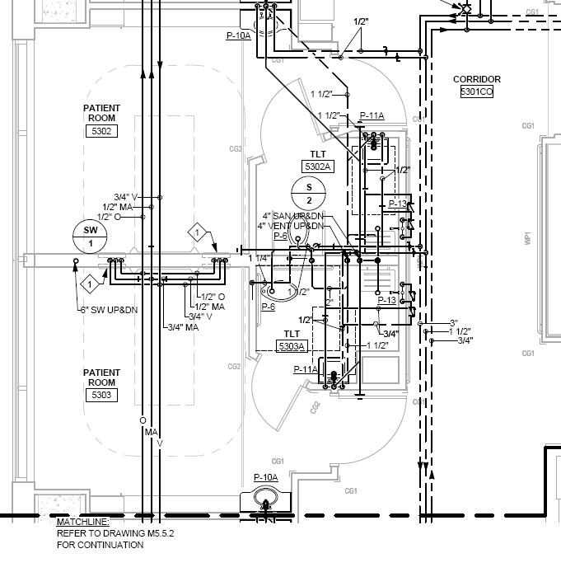
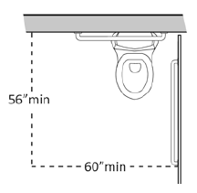
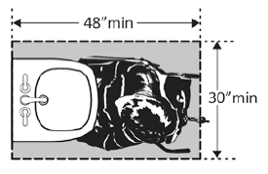
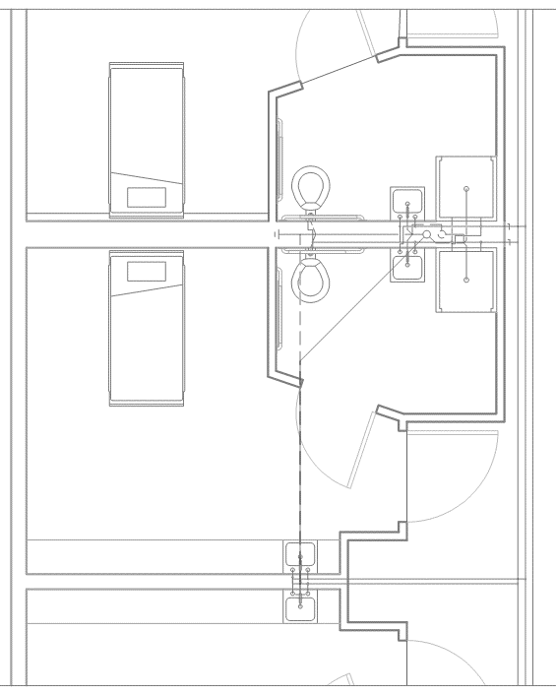
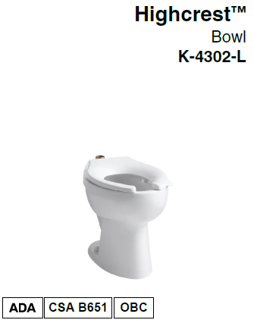
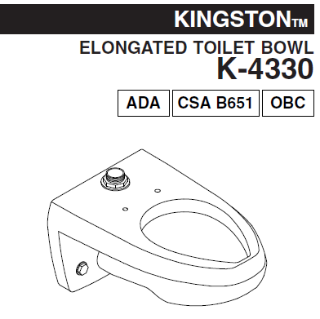
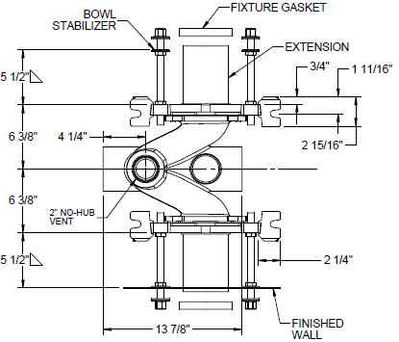
Analysis 2: Patient Room Re-Design for Shared Wet Wall
AE Senior Thesis Project
Joshua Miller | Construction Management Option
Northeast Hospital Expansion
123 Medical Lane, USA
I. Introduction
Project Background
Analysis Overview
II. Analysis 1: Implementing an Integrated Project Delivery
Current Delivery Method
Case Studies of Similar Projects Using IPD
Suggested Methods for Implementation
III. Analysis 2: Patient Room Re-Design for Shared Wet Wall
Existing/Proposed Patient Room Layout
Mechanical Breadth: Piping Re-Sizing
Cost and Schedule Impact
IV. Analysis 3: SIPS Utilization for Patient Floors
Original Crew Sizes & Proposed Work Zones
Workflow Balancing
Cost and Schedule Impact
V. Conclusions & Recommendations
VI. Acknowledgements
Existing/Proposed Patient Room Layout
ADA 2010 Considerations
Change of Water Closet and Carrier
Josam Series 12694
Patient Quality of Care
  Pittsburgh’s UPMC Study on Patient Room Size
    Patient Room Area = 220SF is Optimum
    Reduces Patient falls
    Decrease in readmission rate
  Proposed patient room area = 228SF
Existing Patient Room Layout
Proposed Patient Room Layout

Slide 14
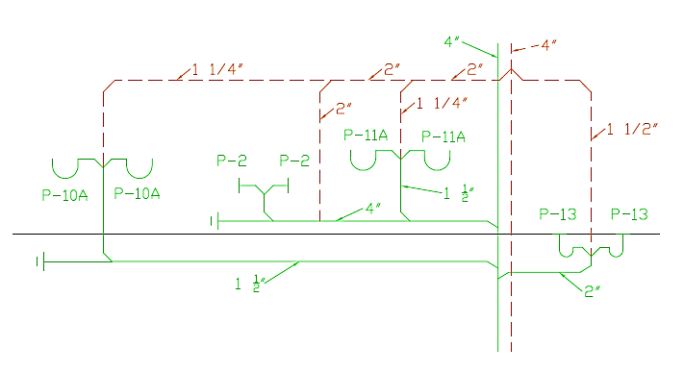
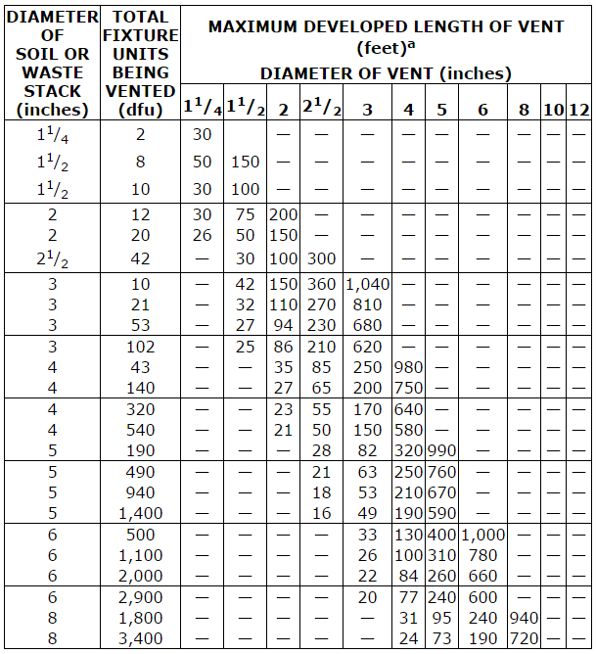
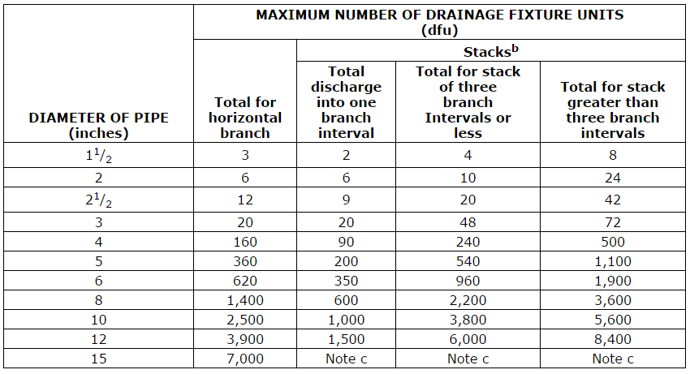
Analysis 2: Patient Room Re-Design for Shared Wet Wall
AE Senior Thesis Project
Joshua Miller | Construction Management Option
Northeast Hospital Expansion
123 Medical Lane, USA
I. Introduction
Project Background
Analysis Overview
II. Analysis 1: Implementing an Integrated Project Delivery
Current Delivery Method
Case Studies of Similar Projects Using IPD
Suggested Methods for Implementation
III. Analysis 2: Patient Room Re-Design for Shared Wet Wall
Existing/Proposed Patient Room Layout
Mechanical Breadth: Piping Re-Sizing
Cost and Schedule Impact
IV. Analysis 3: SIPS Utilization for Patient Floors
Original Crew Sizes & Proposed Work Zones
Workflow Balancing
Cost and Schedule Impact
V. Conclusions & Recommendations
VI. Acknowledgements
Mechanical Breadth: Piping Re-Sizing
Number of Drainage Fixture Units (dfu)
Fixture Type | Dfu Value
Lavatory | 1
Shower (Flow Rate < 5.7 gpm) | 2
Water Closet, public (1.6 gpf) | 4
Table 916.1: Vent Size and Developed Length
Table 710.1 (2): Sanitary Drainage Sizing
Sanitary and Vent Piping Schematic
*Tables referenced from the 2009 International Plumbing Code

Slide 15
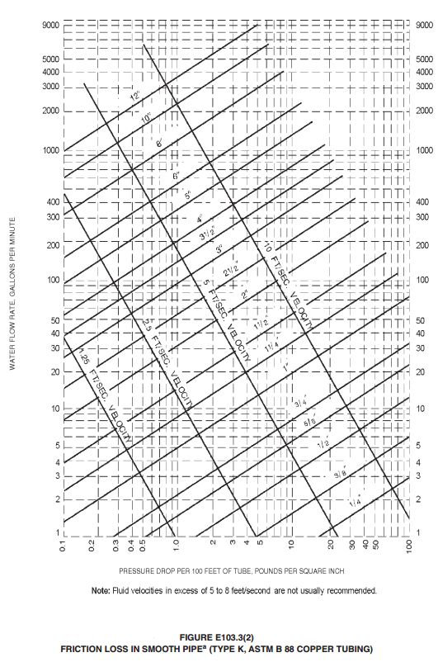
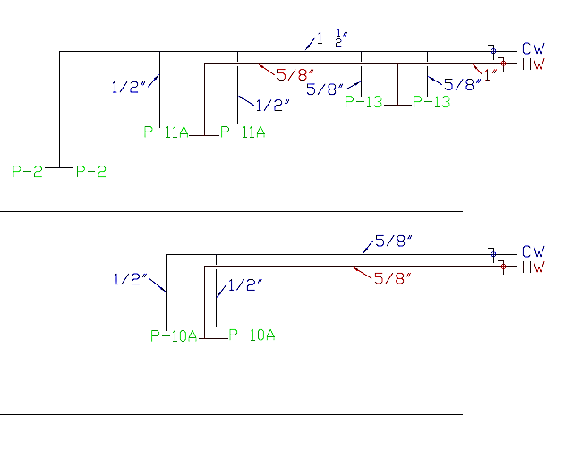
Analysis 2: Patient Room Re-Design for Shared Wet Wall
AE Senior Thesis Project
Joshua Miller | Construction Management Option
Northeast Hospital Expansion
123 Medical Lane, USA
I. Introduction
Project Background
Analysis Overview
II. Analysis 1: Implementing an Integrated Project Delivery
Current Delivery Method
Case Studies of Similar Projects Using IPD
Suggested Methods for Implementation
III. Analysis 2: Patient Room Re-Design for Shared Wet Wall
Existing/Proposed Patient Room Layout
Mechanical Breadth: Piping Re-Sizing
Cost and Schedule Impact
IV. Analysis 3: SIPS Utilization for Patient Floors
Original Crew Sizes & Proposed Work Zones
Workflow Balancing
Cost and Schedule Impact
V. Conclusions & Recommendations
VI. Acknowledgements
Mechanical Breadth: Piping Re-Sizing
Load Value, Water Supply Fixture Units (wsfu)
Fixture Type | Wsfu Values
 | Cold | Hot
Lavatory (Public, Faucet) | 1.5 | 1.5
Shower (Public, Mixing Valve) | 3.0 | 3.0
Water Closet (Public, Flush Valve) | 10.0 | -
8 ft/sec Velocity
Converting from wsfu to Gallon per minute (gpm)
5/8”
Portion of Branch | Wsfu | Gpm
 | 3.0 | 6.5
 | 1.5 | 5.0
1/2”
CW and HW Supply Piping Schematic
*Tables referenced from the 2009 International Plumbing Code

Slide 16
Analysis 2: Patient Room Re-Design for Shared Wet Wall
AE Senior Thesis Project
Joshua Miller | Construction Management Option
Northeast Hospital Expansion
123 Medical Lane, USA
I. Introduction
Project Background
Analysis Overview
II. Analysis 1: Implementing an Integrated Project Delivery
Current Delivery Method
Case Studies of Similar Projects Using IPD
Suggested Methods for Implementation
III. Analysis 2: Patient Room Re-Design for Shared Wet Wall
Existing/Proposed Patient Room Layout
Mechanical Breadth: Piping Re-Sizing
Cost and Schedule Impact
IV. Analysis 3: SIPS Utilization for Patient Floors
Original Crew Sizes & Proposed Work Zones
Workflow Balancing
Cost and Schedule Impact
V. Conclusions & Recommendations
VI. Acknowledgements
Cost and Schedule Impact
Material Cost Comparison Per Patient Room Pair
Total Schedule & Cost Reduction Summary
System | Existing Design | Proposed Design | Difference | % Change
CW & HW Supply | $1,508.55 | $1,580.26 | ($71.71) | 105%
Sanitary | $10,889.13 | $5,437.89 | $5,451.24 | 50%
Vent | $1,139.27 | $930.69 | $208.58 | 82%
Insulation | $1,353.70 | $794.88 | $558.82 | 59%
Total | $14,890.65 | $7,948.84 | $6,941.81 | 53%
Design | Schedule Acceleration | Material Costs | Labor Costs | Total Cost
Existing | - | $670,079.25 | $435,192.30 | $1,105,271.55
Proposed | 93 days | $357,697.80 | $214,814.70 | $572,512.50
Savings
$532,759
Labor Hour Comparison Per Patient Room Pair
Labor Costs Comparison Per Patient Room Pair
System | Existing Design | Proposed Design | Difference | % Change
CW & HW Supply | 35.6 | 23.7 | 11.9 | 67%
Sanitary | 108.5 | 47.5 | 61 | 44%
Vent | 27 | 22.7 | 4.3 | 84%
Insulation | 17.1 | 9.4 | 7.7 | 55%
Total | 188.2 | 94 | 94.2 | 50%
System | Existing Design | Proposed Design | Difference | % Change
CW & HW Supply | $2,042.36 | $1,367.62 | $674.74 | 67%
Sanitary | $5,582.68 | $2,440.21 | $3,142.47 | 44%
Vent | $1,166.72 | $965.83 | $200.89 | 83%
Insulation | $ 879.18 | $477.37 | $401.81 | 54%
Total | $9,670.94 | $4,773.66 | $4,897.28 | 49%

Slide 17
AE Senior Thesis Project
Joshua Miller | Construction Management Option
Northeast Hospital Expansion
123 Medical Lane, USA
I. Introduction
Project Background
Analysis Overview
II. Analysis 1: Implementing an Integrated Project Delivery
Current Delivery Method
Case Studies of Similar Projects Using IPD
Suggested Methods for Implementation
III. Analysis 2: Patient Room Re-Design for Shared Wet Wall
Existing/Proposed Patient Room Layout
Mechanical Breadth: Piping Re-Sizing
Cost and Schedule Impact
IV. Analysis 3: SIPS Utilization for Patient Floors
Original Crew Sizes & Proposed Work Zones
Workflow Balancing
Cost and Schedule Impact
V. Conclusions & Recommendations
VI. Acknowledgements
Analysis 3: SIPS Utilization for Patient Floors

Slide 18
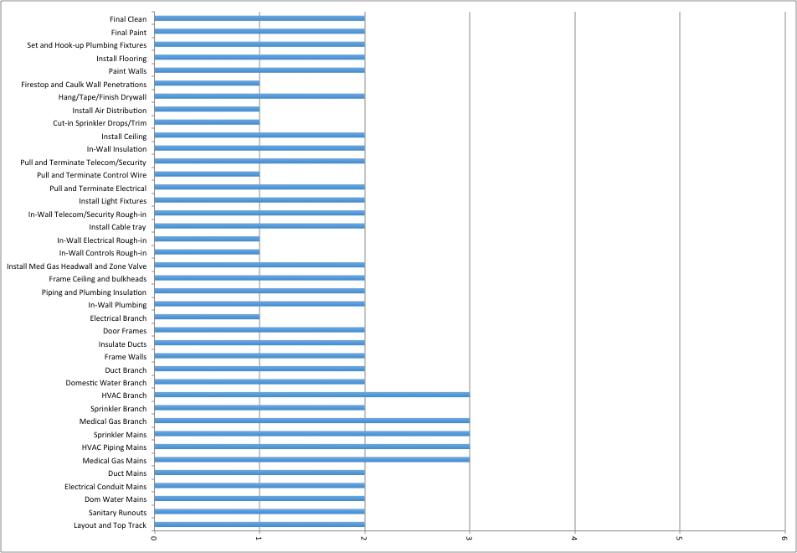
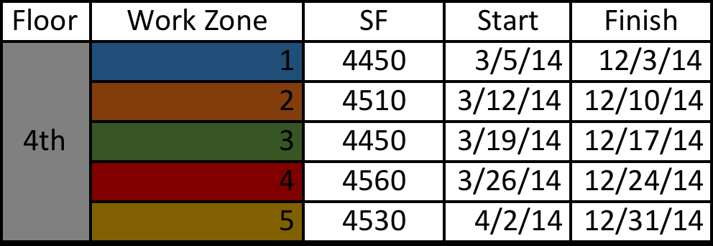
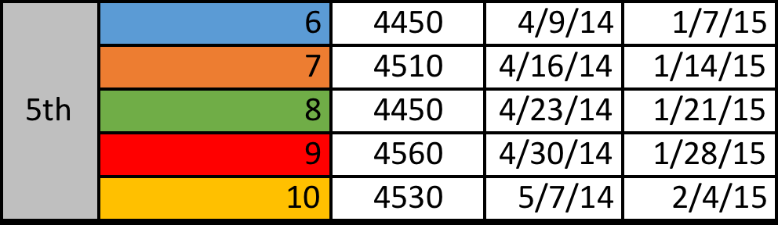
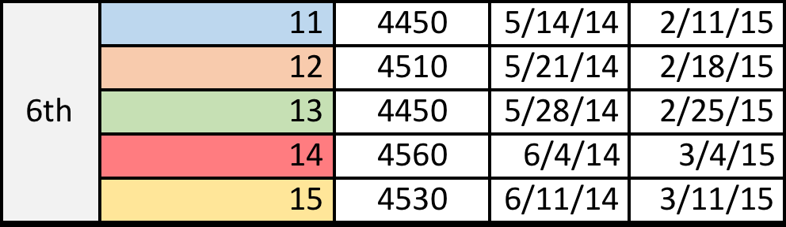
AE Senior Thesis Project
Joshua Miller | Construction Management Option
Analysis 3: SIPS Utilization for Patient Floors
Northeast Hospital Expansion
123 Medical Lane, USA
I. Introduction
Project Background
Analysis Overview
II. Analysis 1: Implementing an Integrated Project Delivery
Current Delivery Method
Case Studies of Similar Projects Using IPD
Suggested Methods for Implementation
III. Analysis 2: Patient Room Re-Design for Shared Wet Wall
Existing/Proposed Patient Room Layout
Mechanical Breadth: Piping Re-Sizing
Cost and Schedule Impact
IV. Analysis 3: SIPS Utilization for Patient Floors
Original Crew Sizes & Proposed Work Zones
Workflow Balancing
Cost and Schedule Impact
V. Conclusions & Recommendations
VI. Acknowledgements
Original Crew Sizes & Proposed Work Zones
6
5
4
3
2
1
0

Slide 19
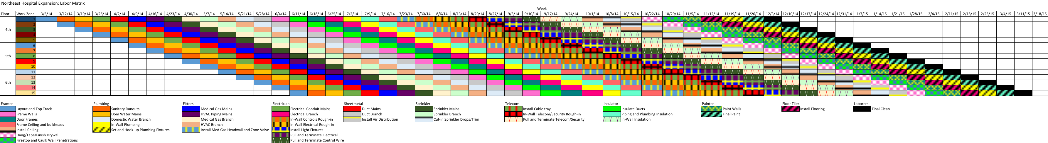
AE Senior Thesis Project
Joshua Miller | Construction Management Option
Analysis 3: SIPS Utilization for Patient Floors
Northeast Hospital Expansion
123 Medical Lane, USA
I. Introduction
Project Background
Analysis Overview
II. Analysis 1: Implementing an Integrated Project Delivery
Current Delivery Method
Case Studies of Similar Projects Using IPD
Suggested Methods for Implementation
III. Analysis 2: Patient Room Re-Design for Shared Wet Wall
Existing/Proposed Patient Room Layout
Mechanical Breadth: Piping Re-Sizing
Cost and Schedule Impact
IV. Analysis 3: SIPS Utilization for Patient Floors
Original Crew Sizes & Proposed Work Zones
Workflow Balancing
Cost and Schedule Impact
V. Conclusions & Recommendations
VI. Acknowledgements
Workflow Balancing
Each Activity has 1 week to complete 1 zone
Crews to complete 900 SF per day

Slide 20
AE Senior Thesis Project
Joshua Miller | Construction Management Option
Analysis 3: SIPS Utilization for Patient Floors
Northeast Hospital Expansion
123 Medical Lane, USA
I. Introduction
Project Background
Analysis Overview
II. Analysis 1: Implementing an Integrated Project Delivery
Current Delivery Method
Case Studies of Similar Projects Using IPD
Suggested Methods for Implementation
III. Analysis 2: Patient Room Re-Design for Shared Wet Wall
Existing/Proposed Patient Room Layout
Mechanical Breadth: Piping Re-Sizing
Cost and Schedule Impact
IV. Analysis 3: SIPS Utilization for Patient Floors
Original Crew Sizes & Proposed Work Zones
Workflow Balancing
Cost and Schedule Impact
V. Conclusions & Recommendations
VI. Acknowledgements
Workflow Balancing
6
5
4
3
2
1
0
(Proposed SF/Day)
(Original Crew Size) = (Proposed Crew Size)
X
(Original SF/Day)
(Proposed Crew Size)
(Hourly Cost/Worker)
8 Hrs = (Total Cost/Day)
X
X
(Total Cost/Day)
5 Days/Zone
5 Zones/Floor = (Total Cost/Floor)
X
X
(Total Cost/Floor)
3 Patient Floors = (Total Project Cost/Activity)
X
Σ(Total Project Cost/Activity) = Total Project Cost

Slide 21
AE Senior Thesis Project
Joshua Miller | Construction Management Option
Analysis 3: SIPS Utilization for Patient Floors
Northeast Hospital Expansion
123 Medical Lane, USA
I. Introduction
Project Background
Analysis Overview
II. Analysis 1: Implementing an Integrated Project Delivery
Current Delivery Method
Case Studies of Similar Projects Using IPD
Suggested Methods for Implementation
III. Analysis 2: Patient Room Re-Design for Shared Wet Wall
Existing/Proposed Patient Room Layout
Mechanical Breadth: Piping Re-Sizing
Cost and Schedule Impact
IV. Analysis 3: SIPS Utilization for Patient Floors
Original Crew Sizes & Proposed Work Zones
Workflow Balancing
Cost and Schedule Impact
V. Conclusions & Recommendations
VI. Acknowledgements
Workflow Balancing
6
5
4
3
2
1
0
(Proposed SF/Day)
(Original Crew Size) = (Proposed Crew Size)
X
(Original SF/Day)
(Proposed Crew Size)
(Hourly Cost/Worker)
8 Hrs = (Total Cost/Day)
X
X
(Total Cost/Day)
5 Days/Zone
5 Zones/Floor = (Total Cost/Floor)
X
X
(Total Cost/Floor)
3 Patient Floors = (Total Project Cost/Activity)
X
Σ(Total Project Cost/Activity) = Total Project Cost

Slide 22
AE Senior Thesis Project
Joshua Miller | Construction Management Option
Analysis 3: SIPS Utilization for Patient Floors
Northeast Hospital Expansion
123 Medical Lane, USA
I. Introduction
Project Background
Analysis Overview
II. Analysis 1: Implementing an Integrated Project Delivery
Current Delivery Method
Case Studies of Similar Projects Using IPD
Suggested Methods for Implementation
III. Analysis 2: Patient Room Re-Design for Shared Wet Wall
Existing/Proposed Patient Room Layout
Mechanical Breadth: Piping Re-Sizing
Cost and Schedule Impact
IV. Analysis 3: SIPS Utilization for Patient Floors
Original Crew Sizes & Proposed Work Zones
Workflow Balancing
Cost and Schedule Impact
V. Conclusions & Recommendations
VI. Acknowledgements
Cost and Schedule Impact
Labor Savings: $12,097.20
Schedule Acceleration:126 days (18 weeks)
Schedule Type | Original | SIPS
Labor Cost | $2,992,027.20 | $2,979,930.00
Start Date | 3/5/14 | 3/5/14
End Date | 7/22/15 | 3/18/15
Duration (days) | 504 | 378

Slide 23
AE Senior Thesis Project
Joshua Miller | Construction Management Option
Conclusions & Recommendations
Northeast Hospital Expansion
123 Medical Lane, USA
I. Introduction
Project Background
Analysis Overview
II. Analysis 1: Implementing an Integrated Project Delivery
Current Delivery Method
Case Studies of Similar Projects Using IPD
Suggested Methods for Implementation
III. Analysis 2: Patient Room Re-Design for Shared Wet Wall
Existing/Proposed Patient Room Layout
Mechanical Breadth: Piping Re-Sizing
Cost and Schedule Impact
IV. Analysis 3: SIPS Utilization for Patient Floors
Original Crew Sizes & Proposed Work Zones
Workflow Balancing
Cost and Schedule Impact
V. Conclusions & Recommendations
VI. Acknowledgements
✔
✔
Analysis 1: Implementing an Integrated Project Delivery
Analysis 3: SIPS Utilization for Patient Floors
Project | Multi-Party contract | Liability Waivers | Risk/ Reward Pool | Integrated Team Structure | Early Involvement of Key Players | Co-location | Network Sharing
Proposed Northeast Hospital Expansion |  |  |  |  |  |  | 
Schedule Type | Original | SIPS
Labor Cost | $2,992,027.20 | $2,979,930.00
Start Date | 3/5/14 | 3/5/14
End Date | 7/22/15 | 3/18/15
Duration (days) | 504 | 378
Savings
$12,097.20
126 days (18 weeks)
✔
Analysis 2: Patient Room Re-Design for Shared Wet Wall
Design | Schedule Acceleration | Material Costs | Labor Costs | Total Cost
Existing | - | $670,079.25 | $435,192.30 | $1,105,271.55
Proposed | 93 days | $357,697.80 | $214,814.70 | $572,512.50
Savings
$532,759.05
General Conditions: $13,027,770 Total
973 total original work days
$13,389.28 per day

Slide 24

AE Senior Thesis Project
Joshua Miller | Construction Management Option
Acknowledgements
Northeast Hospital Expansion
123 Medical Lane, USA
I. Introduction
Project Background
Analysis Overview
II. Analysis 1: Implementing an Integrated Project Delivery
Current Delivery Method
Case Studies of Similar Projects Using IPD
Suggested Methods for Implementation
III. Analysis 2: Patient Room Re-Design for Shared Wet Wall
Existing/Proposed Patient Room Layout
Mechanical Breadth: Piping Re-Sizing
Cost and Schedule Impact
IV. Analysis 3: SIPS Utilization for Patient Floors
Original Crew Sizes & Proposed Work Zones
Workflow Balancing
Cost and Schedule Impact
V. Conclusions & Recommendations
VI. Acknowledgements
Industry Acknowledgements:
Whiting-Turner
Southland Industries
CBRE Healthcare
Special Thanks To:
John Ovelman – Whiting-Turner
Chris Brooks – Southland Industries
Raj Vora – Southland Industries
John Carbonneau – Southland Industries
Adam Davis – Penn State Office of Physical Plant
Mark Bittner – CBRE Healthcare
Jake Hughes – CBRE Healthcare
PACE Industry Members
My Friends, Family, and A-7
Academic:
Penn State Architectural Engineering Faculty
Dr. Craig Dubler – Faculty Advisor

Slide 25
Northeast Hospital Expansion
Courtesy of Smith Group JJR
Questions?
Questions?
Thank you

